Slide 1
Overview of AI Models

Slide 2
What do people mean when they say something is "AI"
Outside of CS/Engineering, it often means ChatGPT
Or some other LLM/Transformer model tailored to a specific application
I wish I could say there is 1 commonly accepted definition of AI, but there isn't
Often techniques fall along some sort of spectrum of data science <-> machine learning
But the general AI terms usually encompasses a way to have a machine make intelligent or human level decisions

Slide 3
Machine Learning
Generally accepted as a sub-set of AI
Though Machine Learning and AI are often used interchangeably, and sometimes people only include machine learning in what they accept as AI
Machine learning typically involves data-intensive techniques where the algorithm is learning how to perform as task based on a dataset
Neural Networks/Transformers/ChatGPT fall under machine learning
So do a lot of other popular methods

Slide 4
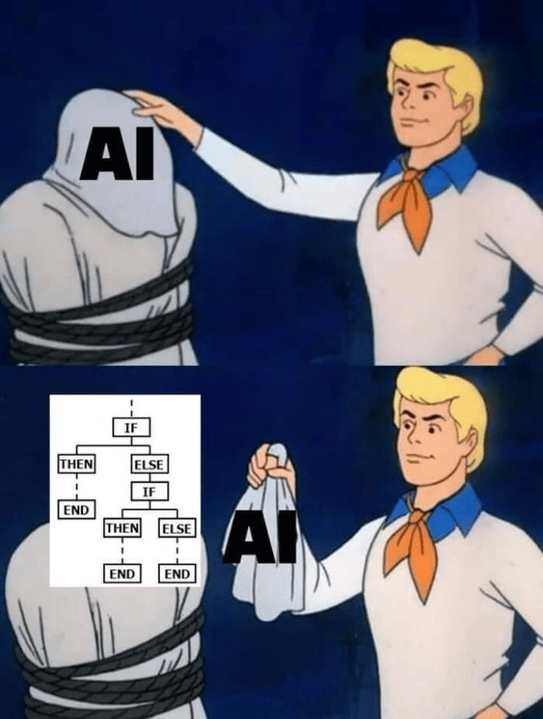
How do we organize how we think about AI models?
Good luck!
But's let's try anyway.
https://cheezburger.com/19767045/the-funniest-programming-memes-of-the-week-march-19-2023

Slide 5
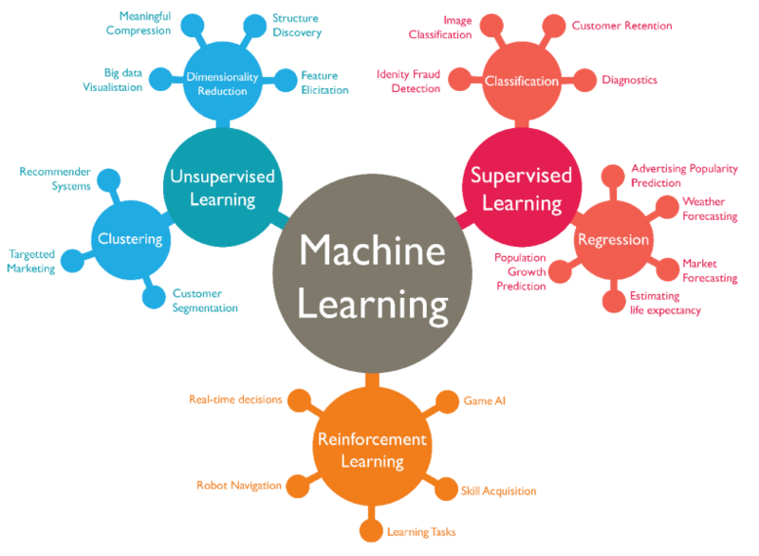
AI taxonomies
This one from LinkedIn is pretty good: https://www.linkedin.com/pulse/artificial-intelligence-5-taxonomy-machine-learning-deep-ajit-jaokar/

Slide 6
AI taxonomies
This one from medium is good too: https://frickingruvin.medium.com/artificial-intelligence-ai-taxonomies-caa2ddc6cc7e

Slide 7
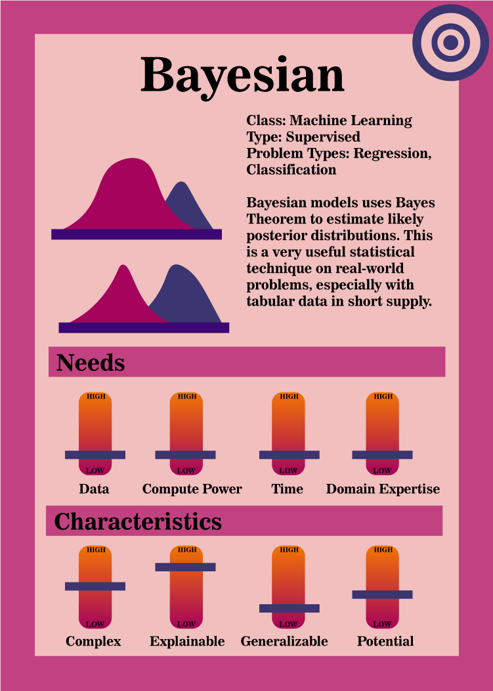
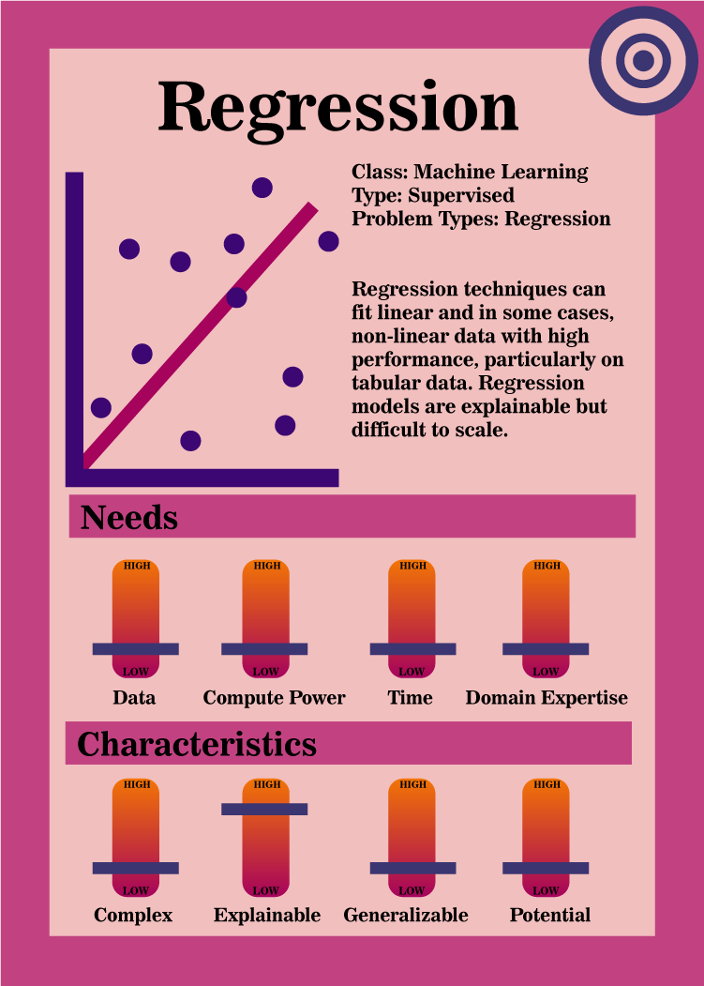
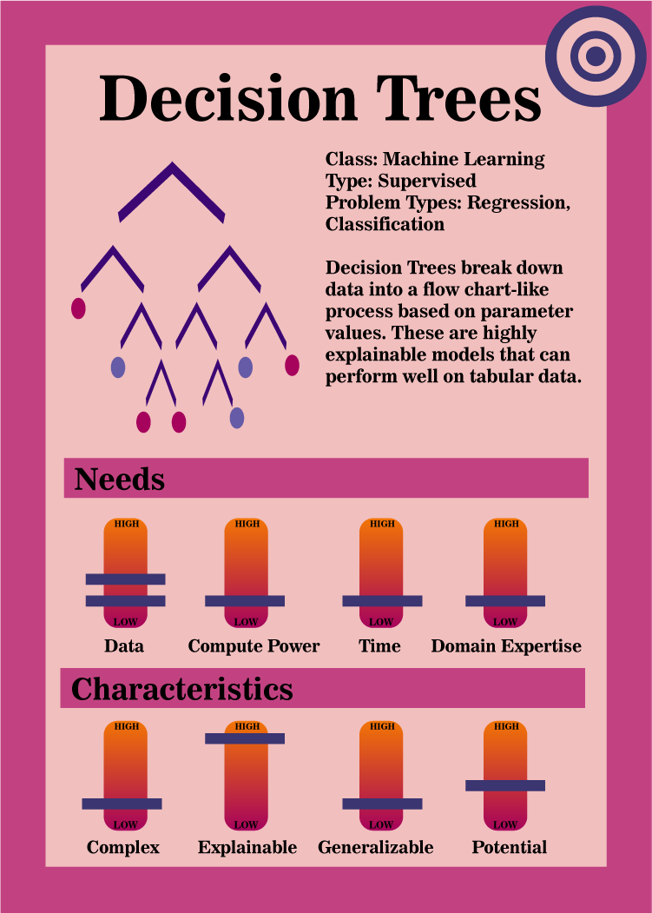

Slide 8
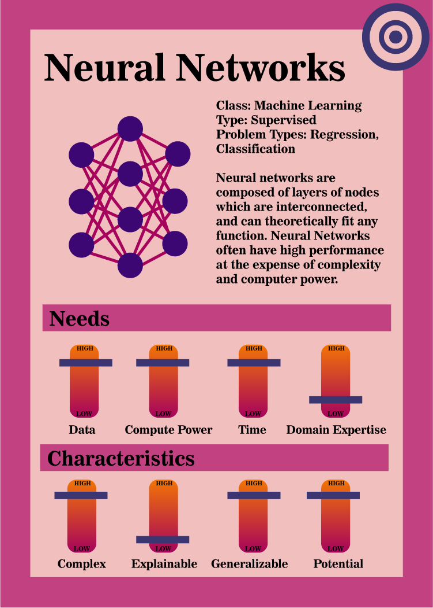
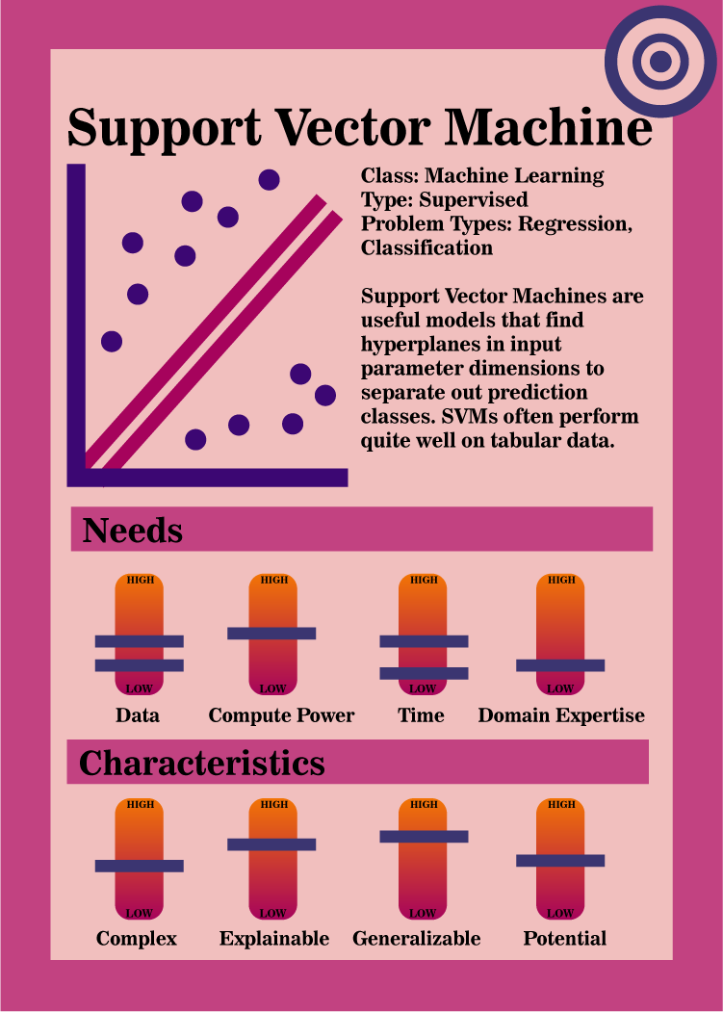
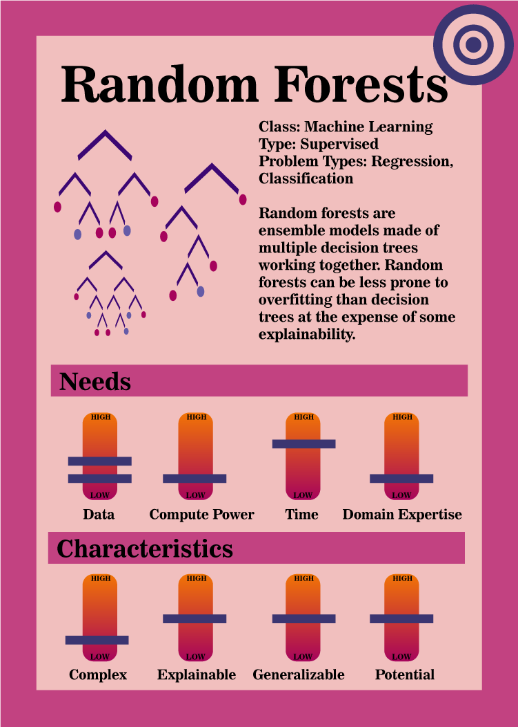

Slide 9
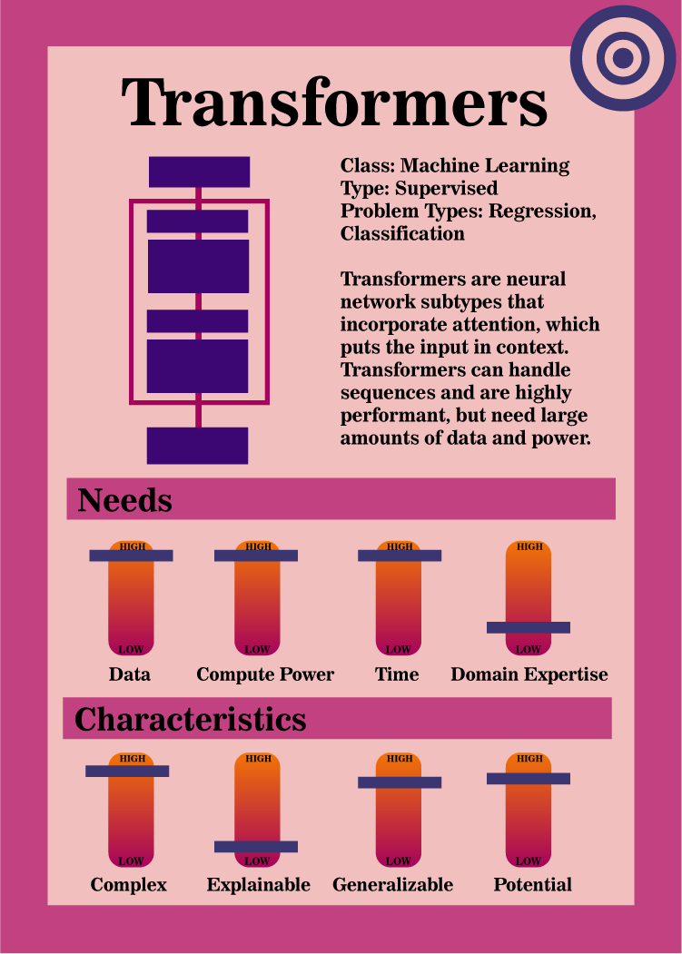
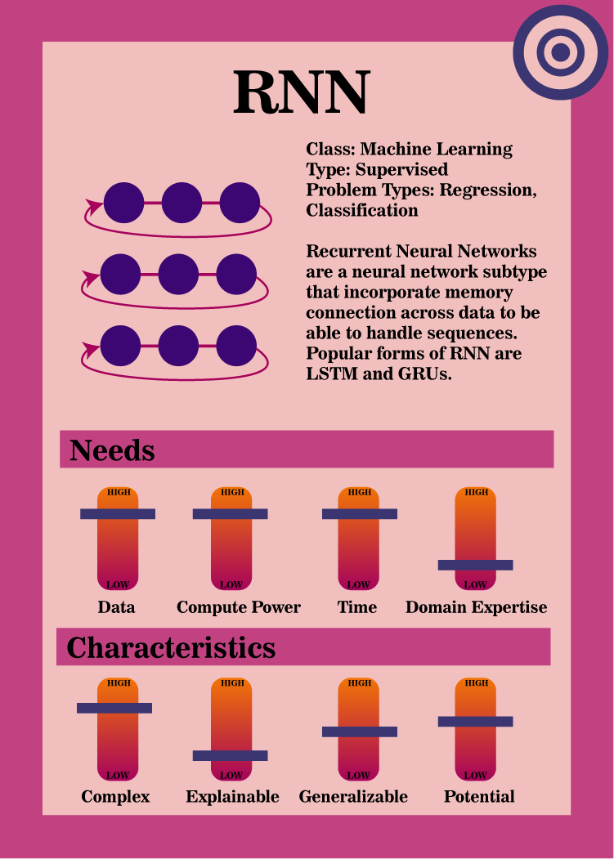
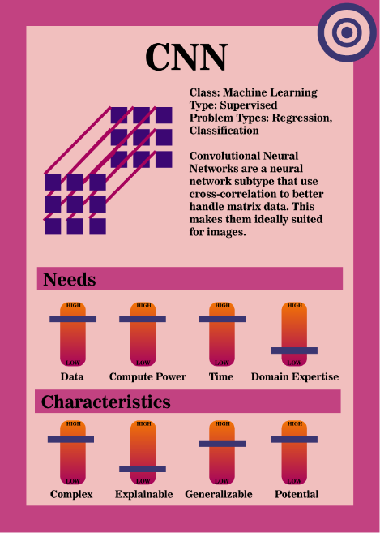

Slide 10
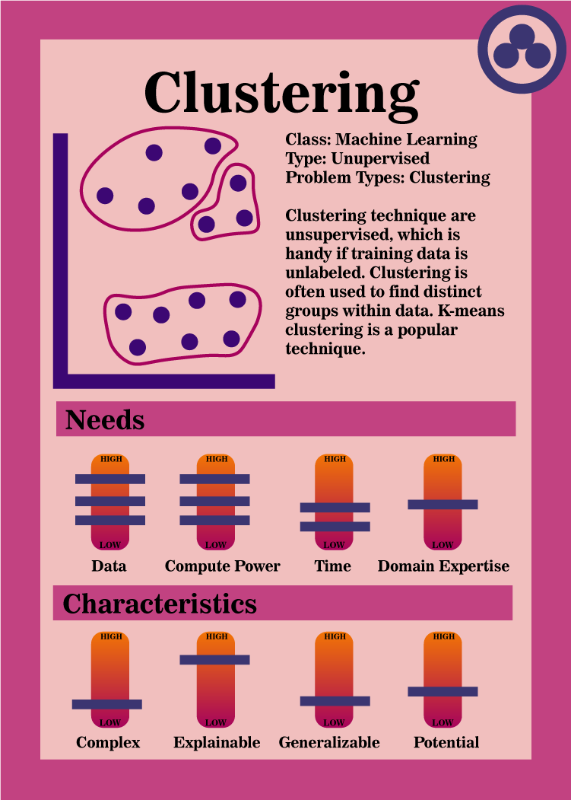
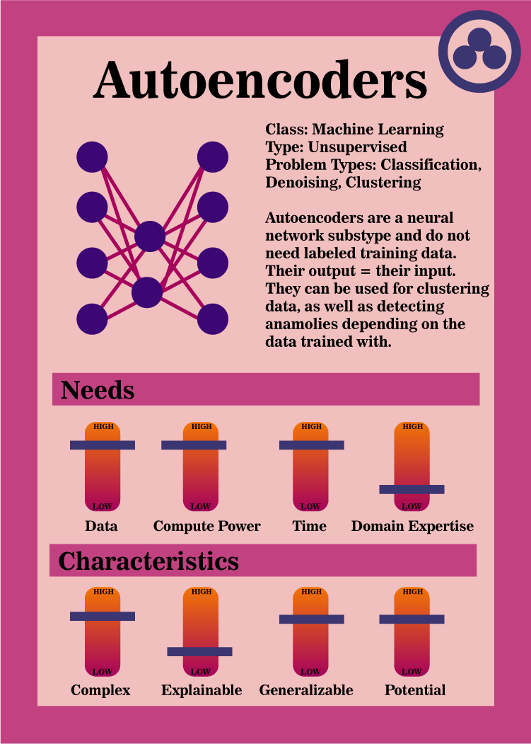
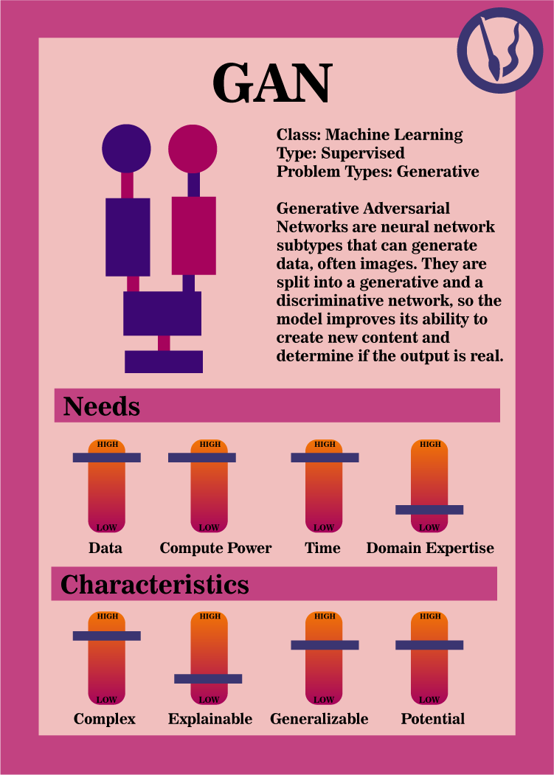

Slide 11
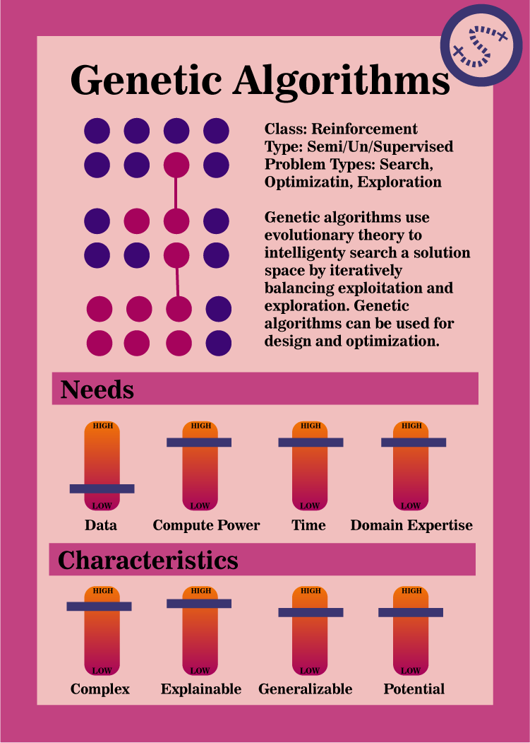
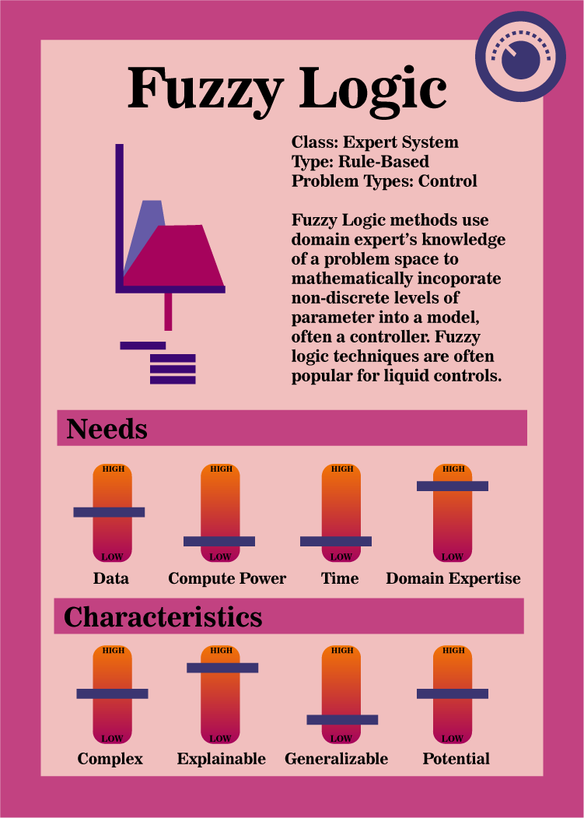

Slide 12
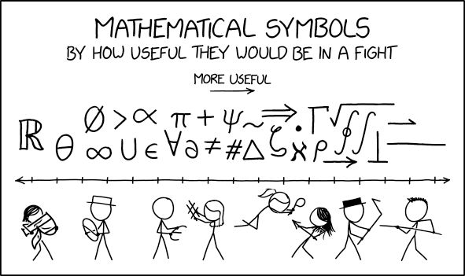
Tips
One of the most difficult things about learning how AI models work
… Is the freaking notation
https://www.pinterest.com/pin/oh-no-a-musician-just-burst-in-through-the-door-confidently-twirling-a-treble-clef--742882901026442492/

Slide 13
Basic Concepts
What's in a Dataset
Types of Machine Learning
Data
Model Evaluation

Slide 14



Datasets
For supervised, machine learning, generally use a dataset with:
Input data – Data you will already have and will give to the model to get some sort of result
Output data – Results of interest that you want a model to be able to generate.
For most supervised learning:
You will have input and output data already in a dataset
You will use the input data to train the model, and the model will generate model outputs
You will use output data to compare against the model outputs and generate model error, which helps train the model
In production, the model will generate model outputs from known input data, and you will not have known outputs to compare it to

Slide 15

Dataset - Example
Wine Quality Dataset
Let's pretend we are wine makers
We have a dataset that has features related to the wine: acidity, sugars, chlorides, density, pH, and wine quality
What's useful for us to predict when making a new wine
What is our input data?
What is out output data?
https://br.ifunny.co/picture/with-something-like-that-i-would-have-white-wine-J7OVLDXs9

Slide 16

Wine Dataset
Well, if we are the wine maker, we probably have access to the chemical properties of our wine, like acidity, acids, sugars, chlorides, density, and pH
What we probably don't have access to, right when we make the wine, is the wine quality
But since we assume we can sell a higher quality wine for more, it's useful to predict the wine quality ahead of time
So our input data is the wine chemical properties, which we'll have every time we predict a wine
An our output data is the wine quality
When we have a model running in production, we will NOT have this data - only the model output prediction
But for training the model, we have a historical set of wine quality scores and associated chemical properties

Slide 17
Datasets
We often call the input data a set of features of the dataset
While our output data could be called the answers, the results, the outcomes, features of interest, etc.
A training dataset has both features and outcomes in supervised machine learning
A model in production is only given the features, and it has to generate a predicted outcome

Slide 18

Types of Machine Learning
Supervised
Unsupervised
https://www.reddit.com/r/MemeRestoration/comments/fxyzti/my_attempt_at_restoring_the_jim_halpert_smiling/

Slide 19
Supervised Machine Learning
You have both feature and outcome data in your training set
Your model uses the outcome data to evaluate the model
Example: predict wine quality (outcome) based on pH and chlorides (features)

Slide 20
Unsupervised Machine Learning
You have only the feature data for the model
Typically, the model tries to either cluster features into similar groups
Or, tries to find a dimensionality reduction for the data
For example: try to sort wines into similar categories based on chlorides and pH (features)

Slide 21
Semi-Supervised
Can often use a mix of labeled and unlabeled data
Won't get into this too much right now, just know that it exists

Slide 22
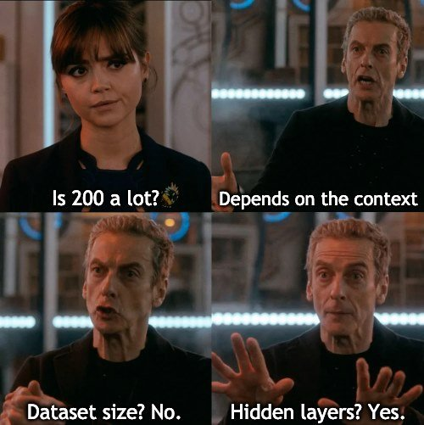
Data
For most models - model output is only as good as data input
You will probably need to look at the data first to determine:
Missing values
Outliers that might screw with your results
Incorrectly entered values
Etc
Generally, the more data you have, the better chance the data is representative of the true population of your problem
Not always the case – in some instances, you need to work harder to get a balanced dataset
Generally, more data is better
BUT!
More data usually means the model will take more time to train, and more data often means needing more computer resources
https://www.kaggle.com/discussions/general/368522

Slide 23
Data
Other important characteristic of how we want to use our data
In machine learning, we rarely care ONLY about how the model fits our existing dataset
Generally, we want to make a model that works well in production on a problem of our choice
In supervised learning we already know (we have the data) that corresponding to our input data
We really want to know how the model will work on new data

Slide 24
Example
Let's say I own a winery and my 2007 vintage "Data Dreams" label was included on the dataset.
I have a prediction model that predicts the wine quality (outcome) based on the alcohol content of the wine (feature)
My alcohol content was 40% and my quality score was a solid 2/10 (I am not very good at making wine)
Let's say I plug my 0.4 alcohol content of "Data Dreams" into my model, and it predicts a score of 1.8. That's pretty close, so I think this might be a great model

Slide 25
Example
However, what I really want to know is how well my model will predict my brand new label, "Regression Canyon" wine quality score
I don't have the quality score for this wine yet, so it's impossible for me to know how close the model will come to it
But – what if I could see how well the model does on data it hasn't seen yet, that I do have the scores for?
Hence – the test set!

Slide 26
Test Set
The test set is data from your dataset that you withhold from a model during the training for the specific purpose of seeing how well your model does on unseen data
A test set allows you to determine how well your model will generalize on new data
Often, after you get the performance metrics on the training dataset, you give the model the test dataset, and its performance on the test dataset is what your report as your model's overall performance
You typically separate your datasets into training and test sets, if your model has the ability to overfit the data

Slide 27
Overfitting
Overfitting means the model generates predictions that are too specific to the training data and do not accurately reflect data not in the training set
For example: say I'm a data-driven but very lazy wine maker and I only collected statistics for 3 wines
If I only have 3 wines and run a linear regression on all 3, chances are my model will have nearly perfect performance
If I have only three wines in my dataset and use two wines to train the model and one wine to test the model, then my training statistics will probably also be perfect.
But at least my one test wine will probably have a high enough error to tell me that:
my model
absolutely
sucks.

Slide 28
Overfitting
Even when you have lots of data, some AI models more prone to overfitting than others
Really deep neural networks can sometime memorize data (more on that later)
Tradeoff between how much data to use to train a model effectively and how much you should withhold to determine how well your model can generalize
Some popular splits are 80/20 and 90/10 but it depends on your problem

Slide 29
Data – Test Training and Validation
We have gone over the training set
We have gone over the test set
You will often also use an additional withheld set, a validation set, to use as a mini-test set during model training (for example, at end of epoch)
More on that later

Slide 30
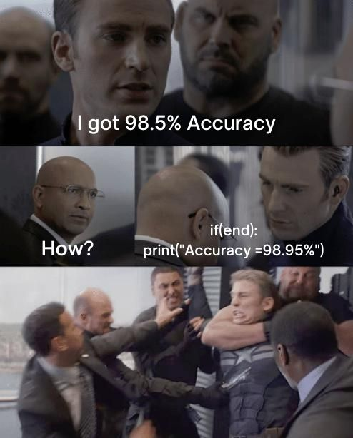
Evaluating the Model
Basically two ways we can look at model performance
How well the model did
Accuracy
Etc
Optimal fitness function
How much the model sucked
Error function/loss function/Cost function
For a lot of models, you pick one metric for training but monitor multiple
Slightly more common to use the "how much the model sucked" metric for supervised machine learning
Slightly more granular, often
https://www.kaggle.com/discussions/general/368522

Slide 31
Evaluating the Model
For example, let's think about our wine quality model
What we care about is accuracy
But we will train our model on some quantification of the error
Lots of potential error functions
Mean squared error
Mean average error
Root mean squared error
Cross Entropy Loss
Etc
We will get into specifics ones when we dicuss specific models
Why might a cost/error/loss function be more specific than an accuracy function?

Slide 32
A Quick Aside on Data

Slide 33
The Hardy Boys Casefiles Problem

Slide 34

The Hardy Boys Casefiles
Not the same as the original Hardy Boys Series
127 novel reboot from 1987-1998 with "higher stakes"
Hilariously terrible cover art
Lewiston City Library and Asotin County Library had a huge amount of these
One summer in elementary school I read 70 of them
I can guarantee you, they follow a formula
https://hardyboys.fandom.com/wiki/The_Hardy_Boys_Casefiles

Slide 35

Question
Could we build a machine learning model to predict if a given suspect in a Hardy Boys Casefile novel was the main villain?
What characteristics might we use as input?
https://www.abebooks.com/9780671700478/Power-Play-Hardy-Boys-Casefiles-0671700472/plp

Slide 36

Characteristics
Age
Gender
Occupation
Friendliness
Suspicion Level
Relationship to Protagonists
Average Proximity to Crime Scene(s)
https://www.amazon.com/Tagged-Terror-Hardy-Boys-Casefiles/dp/0671731122

Slide 37

Dataset
Suspect name is the row identifier
Input features – Our characteristics
Output feature – Binary – Villain or not
127 novels * avg 4 suspects per novel = 508 instances to train on
https://hardyboys.fandom.com/wiki/Flesh_and_Blood

Slide 38

Machine Learning Model
Supervised Learning
Could do a test train split
Evaluate on Accuracy
https://www.hardyboyscasefiles.com/series/casefiles.php?book_no=22

Slide 39

How would this ML model do?
https://www.exlibrismichigan.com/products/the-hardy-boys-casefiles-88-inferno-of-fear-by-franklin-w-dixon

Slide 40
How would this ML model do?
You picked very reasonable features
https://www.exlibrismichigan.com/products/the-hardy-boys-casefiles-88-inferno-of-fear-by-franklin-w-dixon

Slide 41
How would this ML model do?
You picked very reasonable features
For the number of features, you should have plenty of examples
https://www.exlibrismichigan.com/products/the-hardy-boys-casefiles-88-inferno-of-fear-by-franklin-w-dixon

Slide 42
How would this ML model do?
You picked very reasonable features
For the number of features, you should have plenty of examples
Your dataset isn't terribly unbalanced (1/5-2/5 of the dataset has the villain class)
https://www.exlibrismichigan.com/products/the-hardy-boys-casefiles-88-inferno-of-fear-by-franklin-w-dixon

Slide 43
How would this ML model do?
You picked very reasonable features
For the number of features, you should have plenty of examples
Your dataset isn't terribly unbalanced (1/5-2/5 of the dataset has the villain class)
Unfortunately, this model would perform terribly
https://www.exlibrismichigan.com/products/the-hardy-boys-casefiles-88-inferno-of-fear-by-franklin-w-dixon

Slide 44

Why?
Because the writers of the Hardy Boys Casefiles surprisingly don't put in that much effort
https://hardyboys.fandom.com/wiki/Endangered_Species

Slide 45
Why?
Because the writers of the Hardy Boys Casefiles surprisingly don't put in that much effort
The formula for the Hardy Boys villains is very simple:
https://hardyboys.fandom.com/wiki/Endangered_Species

Slide 46
Why?
Because the writers of the Hardy Boys Casefiles surprisingly don't put in that much effort
The formula for the Hardy Boys villains is very simple:
Introduced in first 30% of the novel
https://hardyboys.fandom.com/wiki/Endangered_Species

Slide 47
Why?
Because the writers of the Hardy Boys Casefiles surprisingly don't put in that much effort
The formula for the Hardy Boys villains is very simple:
Introduced in first 30% of the novel
Barely in the novel in next 30-60% of the novel
https://hardyboys.fandom.com/wiki/Endangered_Species

Slide 48
Why?
Because the writers of the Hardy Boys Casefiles surprisingly don't put in that much effort
The formula for the Hardy Boys villains is very simple:
Introduced in first 30% of the novel
Barely in the novel in next 30-60% of the novel
Suddenly reappears at 70-75%
https://hardyboys.fandom.com/wiki/Endangered_Species

Slide 49
Why?
Because the writers of the Hardy Boys Casefiles surprisingly don't put in that much effort
The formula for the Hardy Boys villains is very simple:
Introduced in first 30% of the novel
Barely in the novel in next 30-60% of the novel
Suddenly reappears at 70-75%
Was the case in 60 out of the 70 novels I read
https://hardyboys.fandom.com/wiki/Endangered_Species

Slide 50
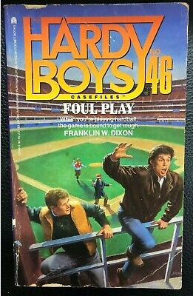
The Best Model in the World
Can't overcome bad data
Especially if the pattern you need is not in the data you are giving the model
https://www.ebay.com/itm/372988356522

Slide 51

Importance of Domain Expertise
If you read these novels, you will probably notice the pattern by your 5th book
But if you hadn't, it's not an obvious thing to track
You always want to work with a domain expert:
To give you an idea if your outcome is present in the data
To tell you about worthless values/how to clean
To interpret your results
https://www.fantasticfiction.com/d/franklin-w-dixon/mission-mayhem.htm

Slide 52

Questions?
https://bookscouter.com/book/9780671882082-pure-evil-the-hardy-boys-casefiles-97

Slide 53
Gradient Descent

Slide 54
Concepts
Calculus helps us with hopping dimensions
Rate of change
Loss function
Loss environment
Minimizing the loss function
The value behind gradient descent

Slide 55
This is a point.

Slide 56
Properties of the point.
One dimension – a location
Exists alone in the world

Slide 57
What happens if we move the point?
Let's create a time dimension
And start creating a map of point and movement

Slide 58
What happens if we move the point?
Let's create a time dimension
And start creating a map of point and movement

Slide 59
What happens if we move the point?
Let's create a time dimension
And start creating a map of point and movement

Slide 60
What happens if we move the point?
Let's create a time dimension
And start creating a map of point and movement

Slide 61
What do we have now?
Kinda looks like a line
Two dimensions – location and time
Point + change in point = line
We can see that a rate of change over an interval of time added the dimension to create a line

Slide 62
What happens if we move the line?
Let's still keep track of time on an axis
But now we will be moving two dimensions, x and y coordinates

Slide 63
What happens if we move the line?
Let's still keep track of time on an axis
But now we will be moving two dimensions, x and y coordinates

Slide 64
What happens if we move the line?
Let's still keep track of time on an axis
But now we will be moving two dimensions, x and y coordinates

Slide 65
What happens if we move the line?
Let's still keep track of time on an axis
But now we will be moving two dimensions, x and y coordinates

Slide 66
What do we have now?
Kinda looks like a plane
Line + changing the line by moving it = plane
Added a new dimension to our surface

Slide 67
We could keep doing this...
… for an arbitrary number of dimensions
Although, we would have trouble visualizing it, since we tend toward being 3D beings
That's not entirely true of your world perception, but somewhat true of your vision system, so it's hard to graph
Main point: n-dimensional surfaces/manifolds have rates of changed associated with the lower-dimensional surface to create a higher-dimensional surface
And this is really, really useful

Slide 68
Derivative
Allows you to drop a dimension of a surface
And get the rate of change with respect to something
Getting the rate of change is very useful
When you are exploring the surface, but don't know exactly what it looks like
Understanding how steep or shallow the surface is based on where you are now allows you to gain information about how to explore the surface

Slide 69
Hold that thought about surfaces
Because now we are going to talk about error surfaces

Slide 70
When you make a machine learning model
You have model parameters
Can you think of examples from the models we have worked with?

Slide 71
When you make a machine learning model
You have model parameters

Slide 72
When you make a machine learning model
Often you evaluate with a function
Loss function
Cost function
Error function
Examples?

Slide 73
When you make a machine learning model
Often you evaluate with a function
Loss function
Cost function
Error function
Examples?
Mean squared error (MSE)
Mean average error (MAE)
Cross Entropy Loss (We’ll get into later)

Slide 74
Machine Learning Model
You want a good model
So you want the error of your model to be low (minimized)
So you want to find the parameters of the model so that the model error is the lowest it can possibly be
But, especially with a huge model, this can be tricky to know.

Slide 75
Error Surface
You can model/think of your error surface as a function
Input: model parameters (whatever they may be – like coefficients, probabilities, weights/biases, etc)
Output: Error of the model – MSE, MAE, etc.
Let's look at a pretend model

Slide 76
Pretend Regression problem
M Coefficient of the independent variable (slope) and b (slope intercept, offset) are my parameters
One independent variable
MSE is my error

Slide 77
Error
M
B

Slide 78
M = 0, B = 0, Error = 10
Error
M
B

Slide 79
M = 0, B = 0, Error = 10
Error
M = 1, B = 2, Error = 9
M
B

Slide 80
M = 0, B = 0, Error = 10
Error
M = 1, B = 2, Error = 9
M = 5, B = 5, Error = 5
M
B

Slide 81
M = 0, B = 0, Error = 10
Error
M = 1, B = 2, Error = 9
M = 5, B = 5, Error = 5
M =1, B = 9, Error = 3
M
B

Slide 82
M = 0, B = 0, Error = 10
Error
M = 1, B = 2, Error = 9
M = 5, B = 5, Error = 5
M =1, B = 9, Error = 3
M =9, B = 1, Error = 2
M
B

Slide 83
M = 0, B = 0, Error = 10
Error
M = 1, B = 2, Error = 9
M = 5, B = 5, Error = 5
M =1, B = 9, Error = 3
M =9, B = 1, Error = 2
M =2, B = 7, Error = 1
M
B

Slide 84
We explored the error space with some random values
Our minimum error was where M=2, B=7
Our error was 1
So in our exploration, the model minimum error was 1 when M=2 and B=7
So M=2 and B=7 would be the parameters of our best model. Probably the model we would actually implement

Slide 85
How, in general, do we find this minimum value?
We don't know what the model space looks like
Especially if we have a LOT of model parameters
We can't explore every possible value of the model parameters, even for simple cases
So we need a "smart" way of explore the error space to try and find the model parameters that generate the minimum error

Slide 86
How do we do this?

Slide 87
How do we do this?
Well:
We can often think of our model as a function
Inputs -> model function -> output prediction
And, more often then not, we evaluate our model error with a function
Output prediction ->error function -> model error
So we can create our error surface function
Input ->model parameters -> error function -> model error

Slide 88
Error Surface
We don't really change our input data when we create our model -> it comes from generally a historical dataset and we are trying to fit our model to the data, not the other way around
But we can change our model parameters to minimize the error
So we have a function for the error surface of the model where the inputs are the model parameters and the outputs are the model errors
For linear regression:
F(m, b) = E

Slide 89
How might we have a better idea of trying model parameters to find the error minimum?
We have a function that goes parameters -> error
Why don't we take the derivative of the error with respect to the parameters!
Some constraints:
Function has to be differentiable (often we use hacks to make it so or approximate)

Slide 90
Derivative of the Error Surface Function
What's a derivative?
A rate of change
Inputs + change = additional dimension
Derivative (additional dimension w.r.t. inputs) = Rate of change
Rate of change tells us:
How much the error changes with respect to this input
In other words, how much of the error was this particular parameter responsible for?

Slide 91
How does this help us?
Tells us how much the error changes with respect to the parameter
How much of the error is this parameter to blame for?
If this parameter is responsible for a lot of the error, maybe change it a lot
If this parameter is responsible for only a bit of the error, maybe don't change it as much
Guide the parameter in the direction of where error is minimal
Tells us the direction to go with the parameters to head toward minimal error

Slide 92


Slide 100
Considerations
How "Big" of a step do you take in the right direction?
How to avoid being caught in a local minimum that isn't the global minimum?
When do you stop exploring for the right model parameters?

Slide 101
Local Minimum

Slide 102
Local Minimum

Slide 103
Local Minimum

Slide 104
Local Minimum

Slide 105
Local Minimum

Slide 106
Local Minimum

Slide 107
Local Minimum

Slide 108
Local Minimum
Better Local Minimum

Slide 109
Gradient Descent
This algorithm is called gradient descent
Taking the derivative of the error/loss function with respect to the model parameters in order to find model parameters with minimal error

Slide 110
Gradient Descent
This algorithm is iterative
At each derivative step you update the model parameters, get the error, and try again
You continue doing this until some stopping criteria
0 error ideal but highly unlikely
More likely – you ran out of iterations you want to try, or your model stopped improving, or something similar

Slide 111
Gradient Descent
There are many implementations of gradient descent
Stochastic gradient descent updates the model parameters after calculating the error for each individual training sample. This is sensitive to errors in data and computationally expensive.
Batch gradient descent runs several different training examples in a batch and then averages the error across the batch. It then updates the parameters by taking the derivative of the average error with respect to the parameters.
You could also run an update of the average error from the entire training set of data. Again, computationally expensive, and possibly hard to average for all parameters.
Batch is often the happy medium.

Slide 112
Gradient Descent
Gradient descent is everywhere
Algorithm behind most of the neural networks in the wild
Incredibly popular in supervised machine learning

Slide 113
Gradient Descent
Gradient descent is often sensitive to hyperparameters
Model parameters are what we adjust in the gradient descent training algorithm
But hyperparameters are what we, the programmer/model designer, set and don’t change
The error function we chose to use (MSE, MAE, etc) is a hyperparameter
The step size we adjust by (in neural networks, called the learning rate) is a hyperparameter
How many samples we use to compute the error on is a hyperparameter
When to stop is a hyperparameter

Slide 114
Local Minimum
Less optimal step size parameter
Better Local Minimum
More optimal step size parameter

Slide 115
Gradient Descent
Often gets stuck in a local minimum
Might need to adjust things like hyperparameters to continue to explore spaces
Exploitation/Exploration tradeoff

Slide 116
Local Minimum
Less optimal step size parameter
Better Local Minimum
More optimal step size parameter
Global minimum
May not reach

Slide 117
Gradient Descent
Often gets stuck in a local minimum
Might need to adjust things like hyperparameters to continue to explore spaces
Exploitation/Exploration tradeoff

Slide 118
Questions?
We'll see gradient descent in a lot of places
Keep it in mind

